Slide 1
Predicting the Accident Severity from Sample Dataset
Farrel Grady Savio
August 21, 2020

Slide 2
Business Problem
Data
In this project we will predict accident severity based on different features. This report will be targeted to Police officer to make them more wary for these particular places.
In this project we will use sample dataset "Data-Collision" to solve the problem.

Slide 3
Data Cleaning
We will drop these columns :
INCKEY, COLDETKEY, STATUS : I dont know the importance of matching unique key and secondary key, would be appreciated if someone could tell me as I can't find it on internet.
OBJECT ID, REPORTNO, INTKEY, EXCEPTRSNCODE, EXCEPTRSNDESC, SDOTCOLNUM : Not relevant to predict Severity
SEVERITYCODE.1 : Duplicate of SEVERITYCODE
SEVERITYDESC, SDOT_COLDESC,ST_COLDESC: Description from another columns
INCDATE,INCDTTM : For simplicity
SEGLANEKEY, CROSSWALKKEY : Too many unique Value

Slide 4
Feature Selection
We assume Location where collision happen will be the most important feature to predict accident severity. Followed by Road Condition, Light Condition, Weather and Description of collision. Based on our assumption We will focusing on location (Junction type, Collision Type)

Slide 5
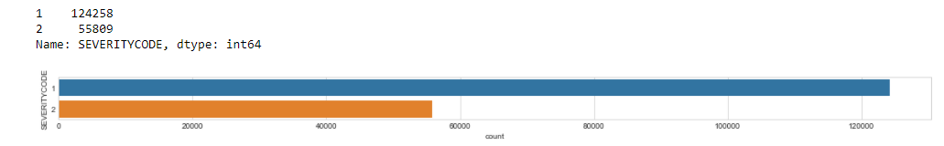
Target Feature : Severity

Slide 6
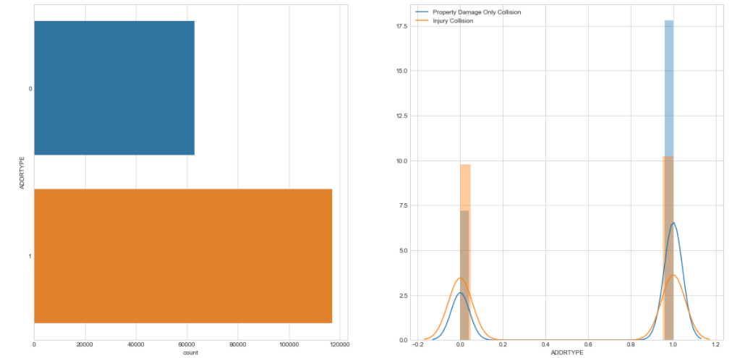
Address Type vs Severity

Slide 7
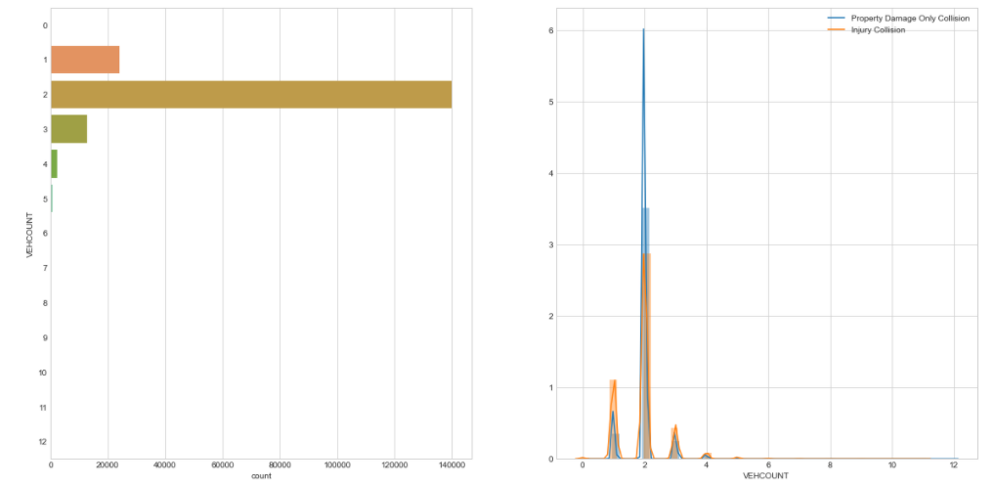
Vehicle Count vs Severity

Slide 8
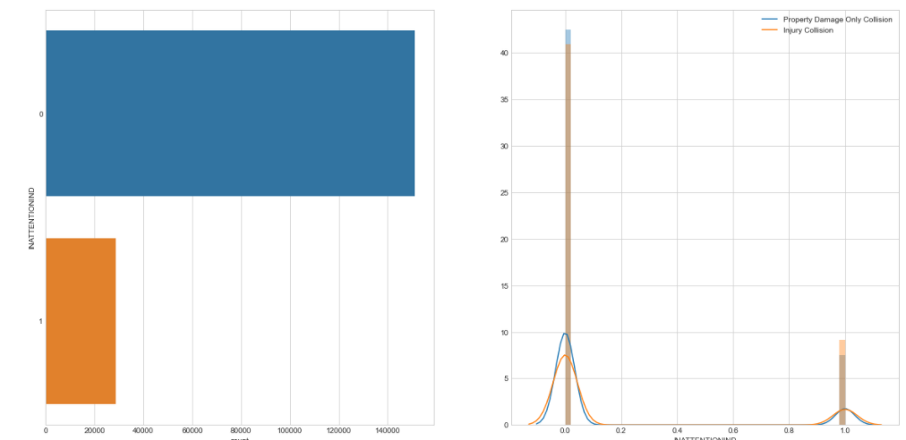
In Attention Vs Severity

Slide 9
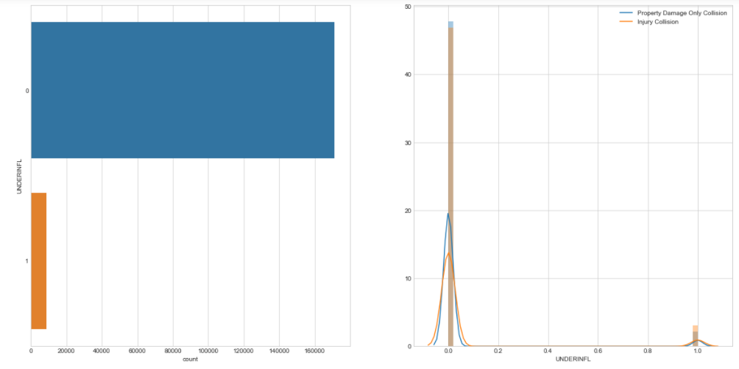
Under Influence vs Severity

Slide 10
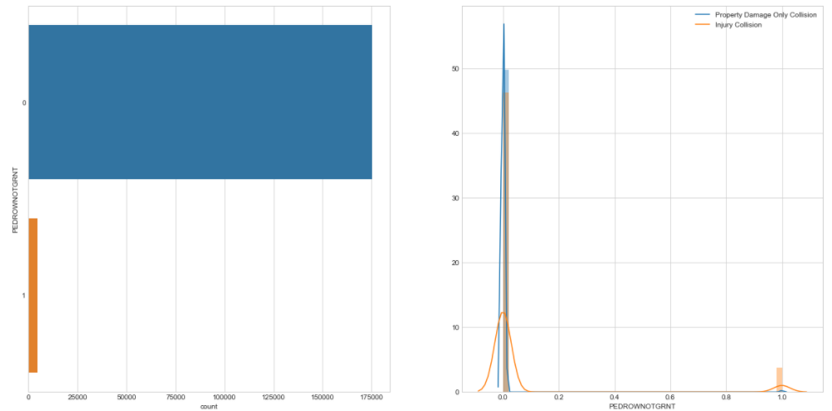
Pedestrian Right of Way Vs Severity

Slide 11
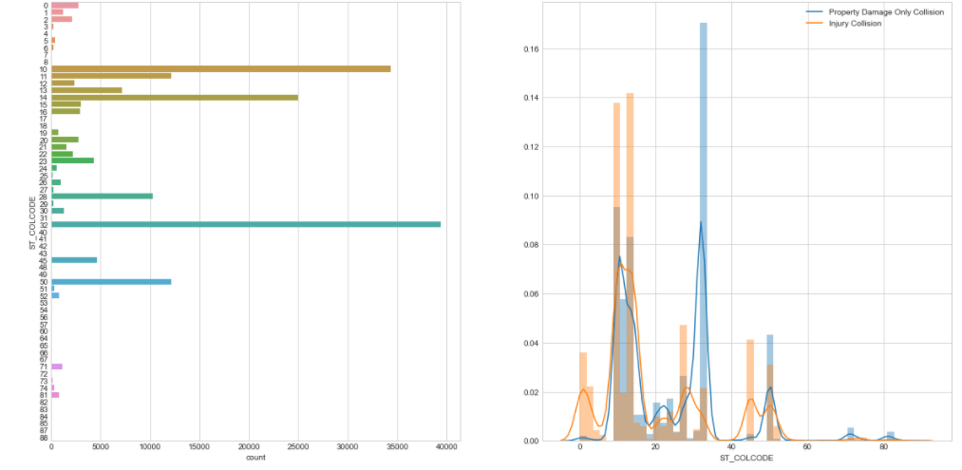
Collision Description Vs Severity

Slide 12
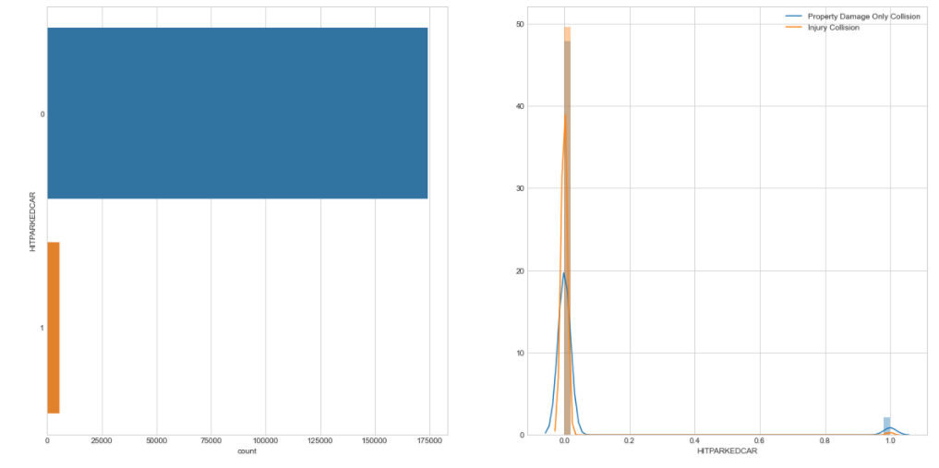
Hit Parked Car vs Severity

Slide 13
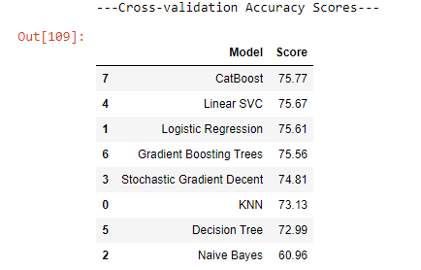
Predictive Modelling Accuracy (10 folds cross validation)

Slide 14
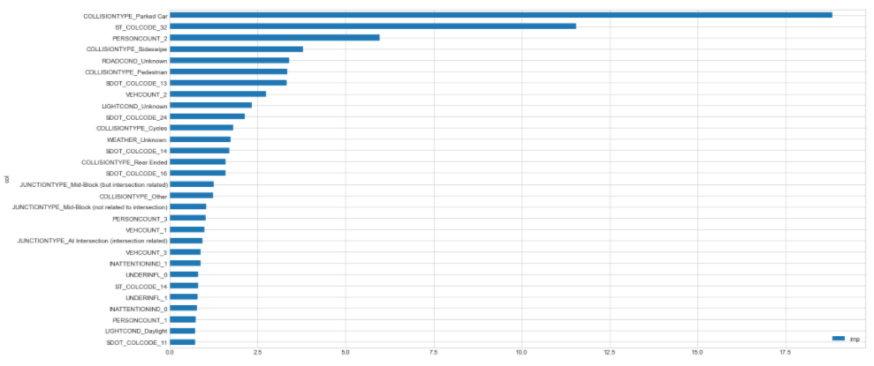
Most Important features in the dataset

Slide 15
Result and Discussion
our ML model manage to predict severity of car accident with 76% accuracy, with the most important feature is Collision type with parked car this is make sense because when there is accident with another parked car most likely it will be a property damage collision.
some feature that I dont use such as INCDATE,INCDTTM could be used to predict whether the accident more likely happen at night, day, weekend, weekdays, etc. We could also group up Person Count when the number reach more than 5, and if the target feature has more than 2 variable it probably more useful in real life (such as 3 = fatality, 2 = serious injury, 1 = injury, 0 = property damage).

Slide 16
Conclusion
Purpose of this project was to predict severity of car accident from sample data that I get from Coursera Capstone, This project is targeted to police officer or any interested stakeholder, Algorithm that I used was CatBoost Algorithm which give our model accuracy of 76%, top 3 feature that is important is Collision Type,State Collision Code and Person Count.

